Slide 1
Web Design & Development Y2/Sem 1
Week 7. advanced Forms

Slide 2
Form Validation
Client-side validation
Validation of form data entered by user – input validation/sanitisation, mandatory fields (e.g. “Username must be at least 8 characters long”
Performed using HTML5 & JavaScript in the browser
Server-side validation
All data should be validated/checked before it is written/stored in database
Web application/site carries out processes out and response or action may be relayed to user (e.g. ”this username already exists”)
Performed on the server after form data is submitted

Slide 3
Client side validation
Advantages
Helps user in the process of filling out form with context related error messages
HTML5 type attribute – text, date, search, url, tel, email & password
HTML5 required attribute – field must have a value
HTML5 pattern attribute – use regular expressions (regex) to ensure correctly formatted input (e.g. that a student id is 8 digits and starts with S00)
getting the right data in the right format
Protects server from malicious activity

Slide 4
Client side validation
Disadvantages
Scripting support can be turned off in the browser (disables client-side validation)
User can alter/modify field controls in the browser – by going into developer tools, selecting an input field and choosing to edit html (e.g. add novalidate attribute to <form> element)

Slide 5
Server side validation
Advantages
Server-side code ensures that data submitted from a form is again validated and sanitised
Allows business process logic validation to be carried out on validated data (e.g. result of business process displayed to the user – “your loan request has been turned down”)
Disadvantages
None – but it’s a severe disadvantage it is not used!

Slide 6
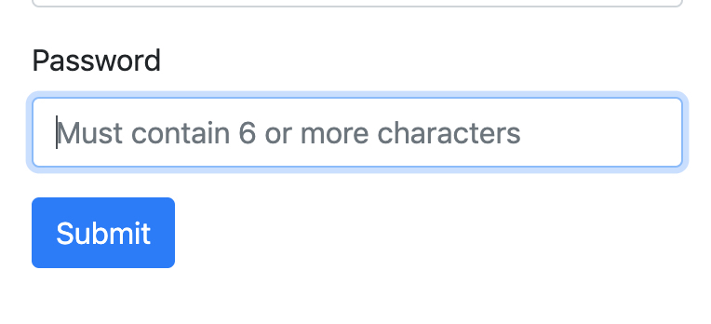
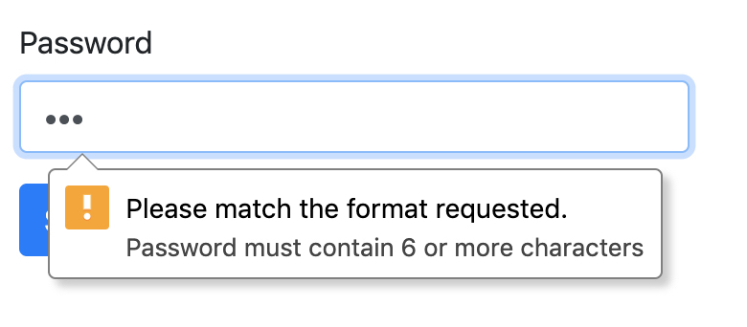
HTML5 pattern attribute
When “Submit” is pressed browser validates input data from user against the regular expression in the pattern attribute.
If data does not validate – error is displayed with text from the title attribute

Slide 7
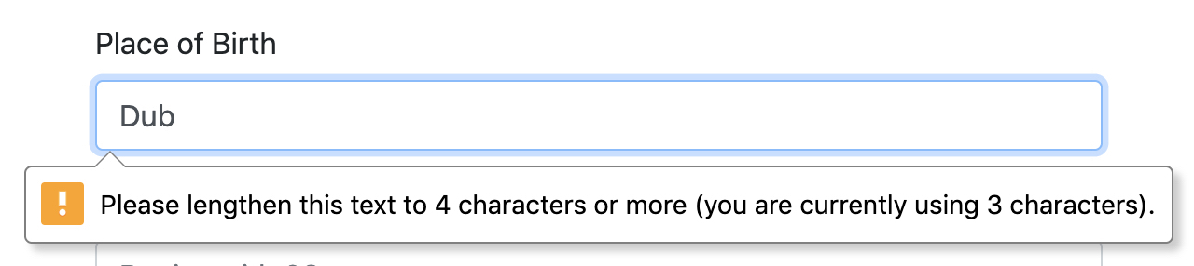
Other input attributes
minlength, maxlength attributes – simple data entry checking on text where patterns/regex not needed
After the user clicks
Submit on the form

Slide 8
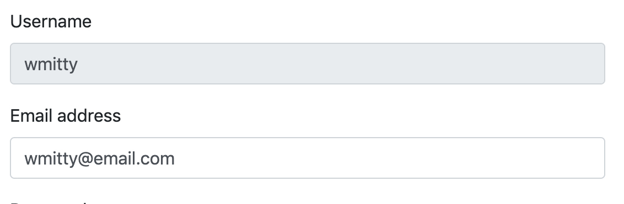
Other input attributes
readonly attribute – user cannot update/edit field
User cannot edit field to
update the value

Slide 9
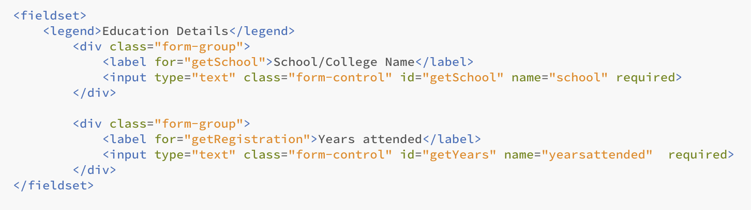
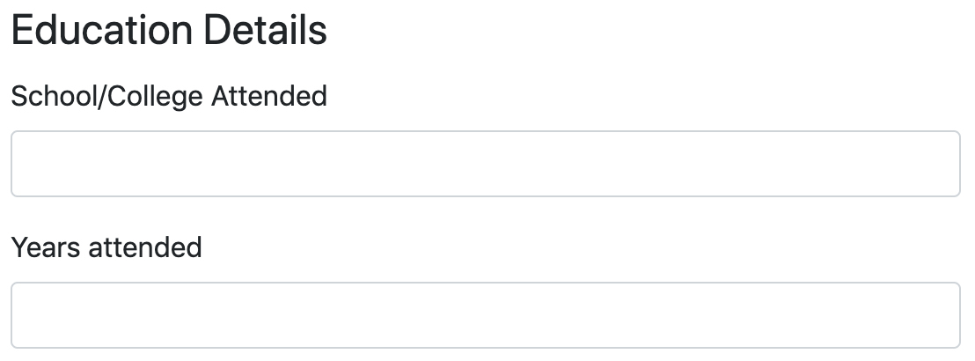
Fieldset – grouping items
<fieldset> element – groups related items in a form. e.g. address details, credit card details. <legend> displays the caption/heading

Slide 10
Constructing regular expressions
Regular expressions also known as regex – describes a certain pattern in pieces of text. Common patterns include:
Mobile phone number, email addresses, bank sort code, Eircode/UK post code, Lab room number, CAO Course Codes
We check for the pattern occurrences in input fields – these patterns allow us generate ways to detect the correct data has been entered
Numbers/alpha-numeric, special characters, spaces, lengths

Slide 11
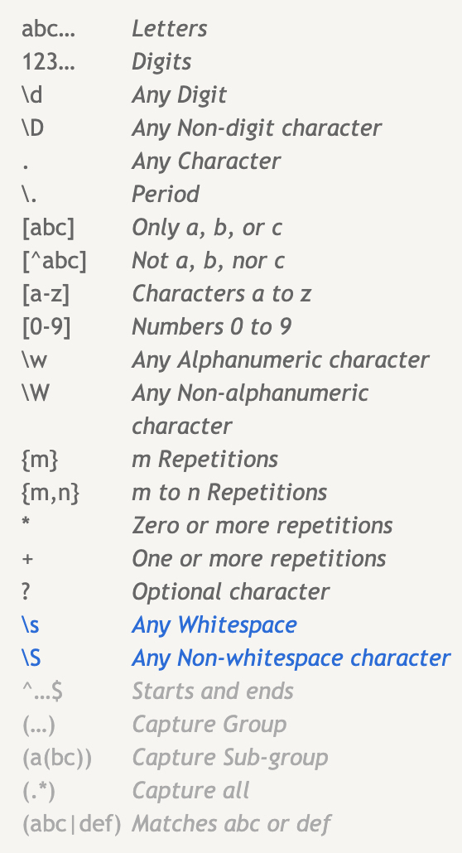
Regex basic syntax
[a-z] lowercase only
[A-Z] uppercase only
[a-zA-Z] case insensitive
[0-9] one number
[0-5] one number from 0 to 5
[0-9]{2} at least 2 numbers (e.g. 26)
[0-9]{1,4} from 1 to 4 numbers
(e.g. 3 or 43 or 741 or 3452)
(SO) text must be SO

Slide 12
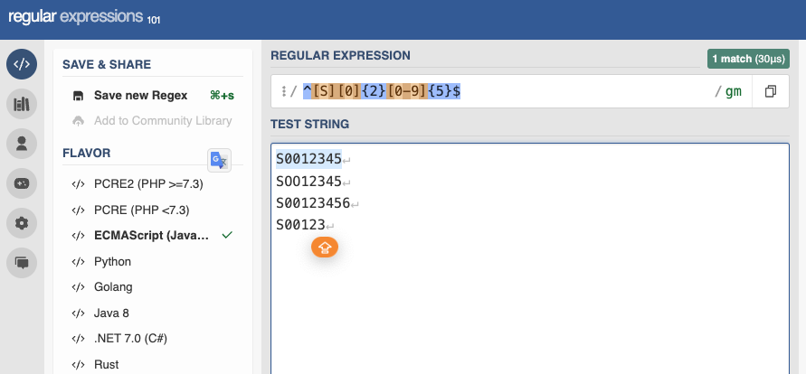
Test, Implement
Testing
Regex101.com - we will use this site to test our expressions
**Set regex flags – g (global), m (multiline)
**Use ^ to start the expression, and $ to end the expression
We need to test our expression with various strings
Implement
Use the pattern attribute on our <input> element
Remove ^ and $

Slide 13
Password regex
pattern=”.{6,}”
Match any number of characters there must be at least 6 (e.g. qwerty56!)

Slide 14
Mobile number regex
pattern=”[0][8][0-9]\s[0-9]{7}"
Must start with 08, followed by a number, a space and finally at least and no more than 7 numbers (e.g. 085 1234567)
i) What is the even simpler regex for this?

Slide 15
Student ID regex
pattern=”[S][0]{2}[0-9]{5}"
Must start with capital letter S, followed by 2 zeros and least and no more than 5 numbers (e.g. S0012345)
ii) What is the even simpler regex for this?

Slide 16
Eircode regex
pattern=”[a-zA-Z][0-9]{2}\s[a-zA-Z,0-9]{4}”
First character is lower case or upper case letter, followed by 2 numbers, followed by a space, and finally of least 4 and no more than 4 alpha numeric characters case insensitive (e.g A65 F4E2)

Slide 17
Car registration regex
pattern=”[0-9]{2,3}\s(SO|MO)\s[0-9]{1,5}"
Year can be 2 or 3 numbers, followed by space, followed by either MO or SO county, followed by space followed by from 1 to 5 numbers (e.g 10 MO 456 or 191 SO 12 or 09 MO 12532)

Slide 18
Links
Test regular expressions
Regex101.com
A Good guide to Regex
https://coderpad.io/blog/development/the-complete-guide-to-regular-expressions-regex/
Find a pattern for doing validation
http://html5pattern.com/

